Slide 1
One World cafe
Faculty Senate Presentation
May 9, 2018

Slide 2
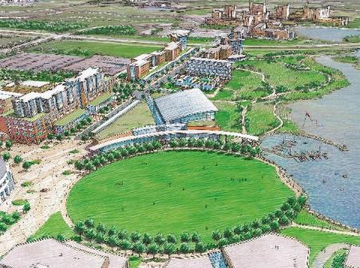
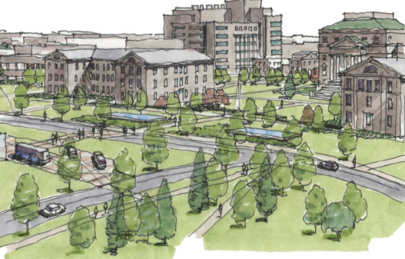
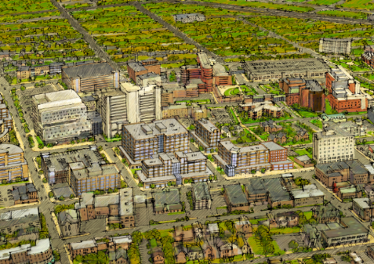
Comprehensive Master Plan
CREATE Downtown Campus by moving JSMBS
REVITALIZE South Campus as Professional Education Center
REORGANIZE North Campus as Undergraduate and Research Center
IMPROVE the campus life experience at all three centers
REDUCE deferred maintenance and address priority infrastructure

Slide 3
heart of the campus
Master Plan

Slide 4
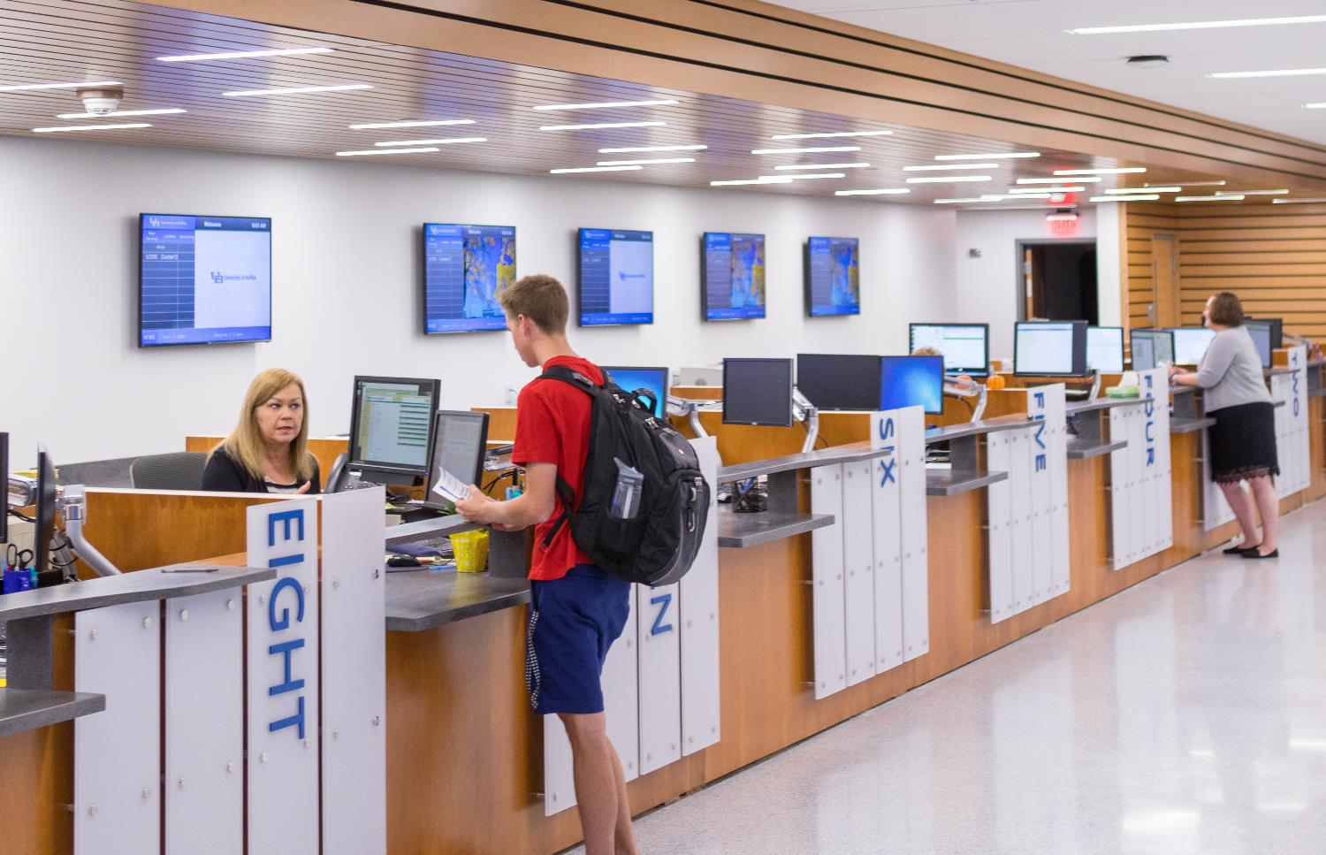
Heart of the Campus Master Plan
Strategic Goals
Consolidate students services and academic support to enhance the students’ experience
Revitalize learning/library environments to reflect learning styles and needs of our students
Foster interaction, transparency and flexibility in our environments
Reinforce the UB brand by creating a place that reflect our mission and spirit

Slide 5
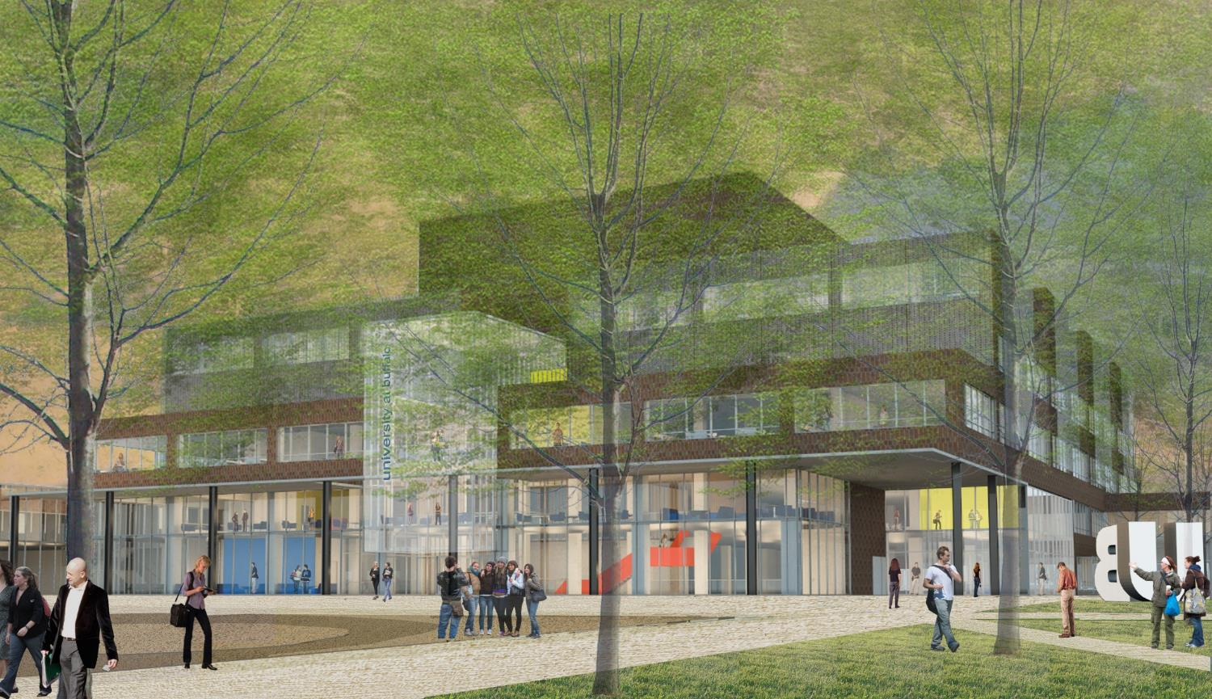

Slide 6
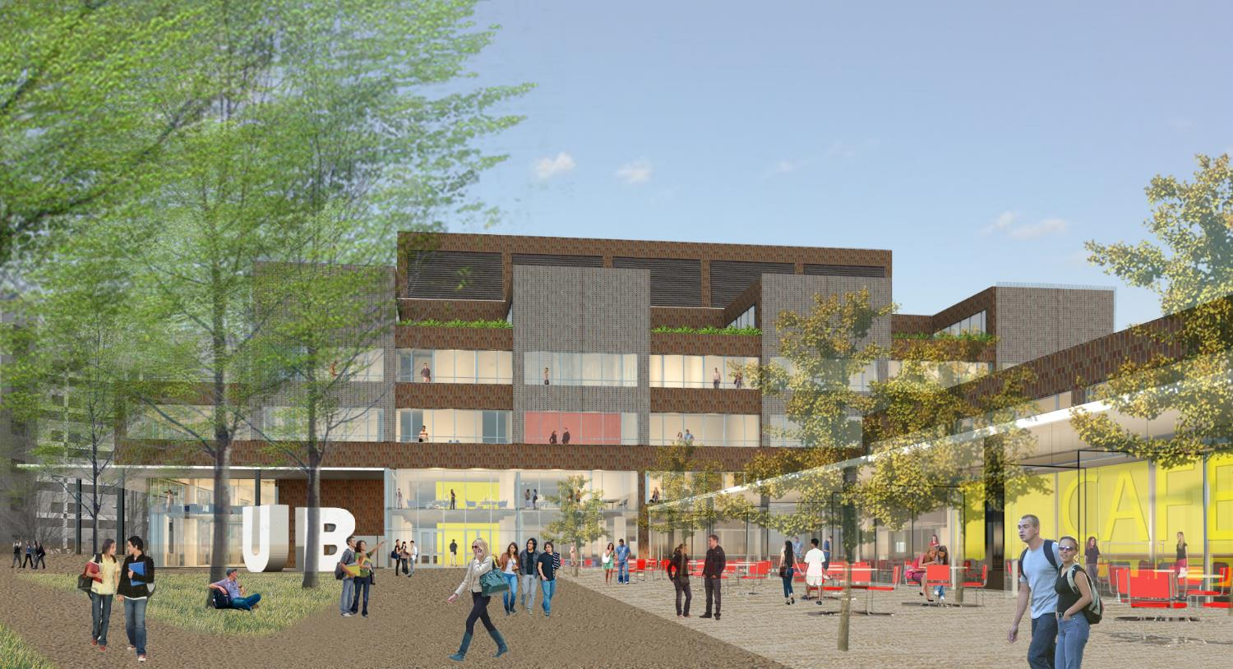

Slide 7
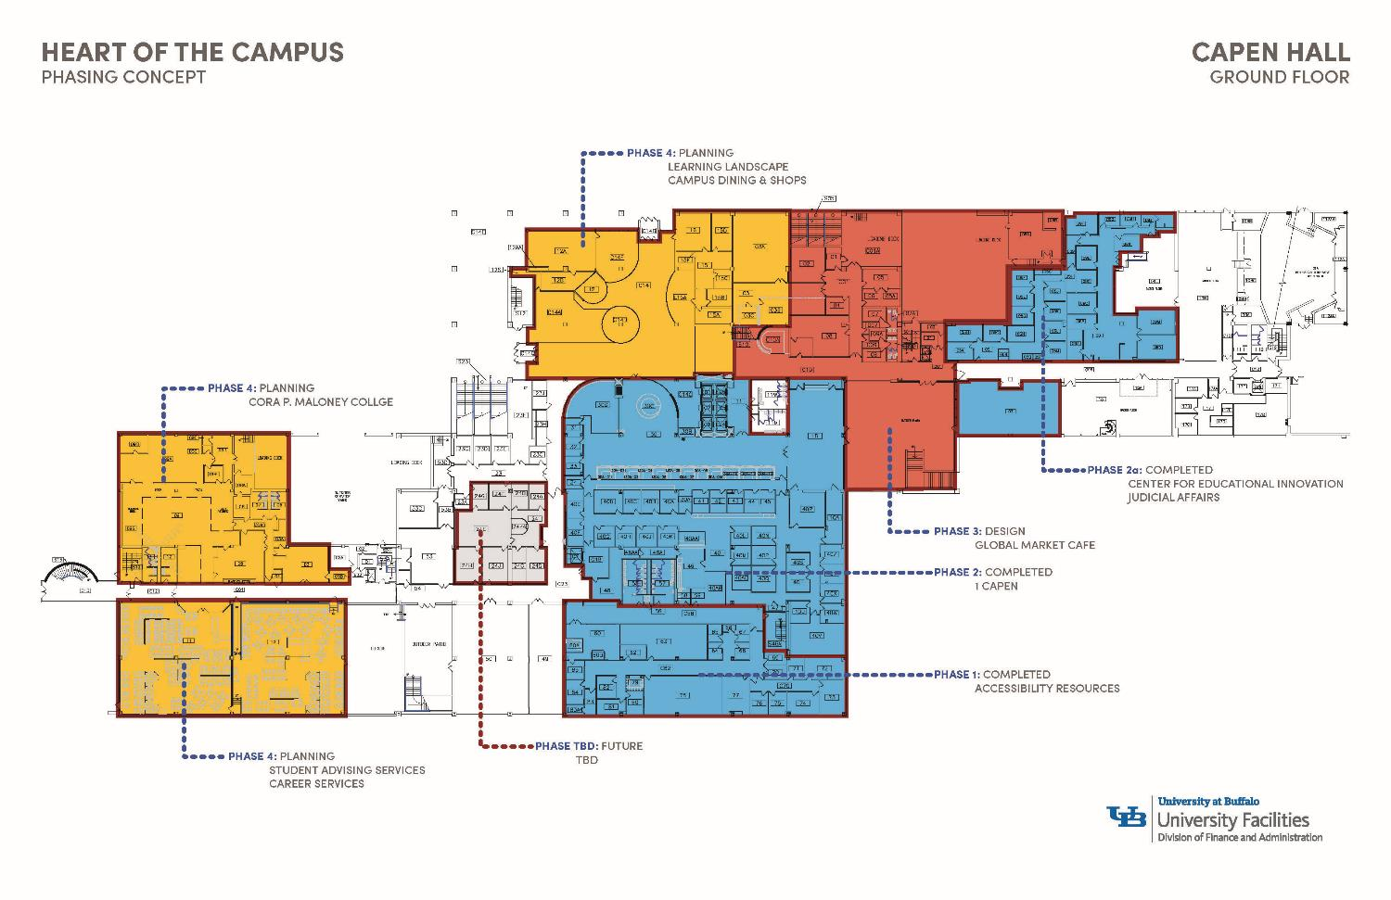

Slide 8
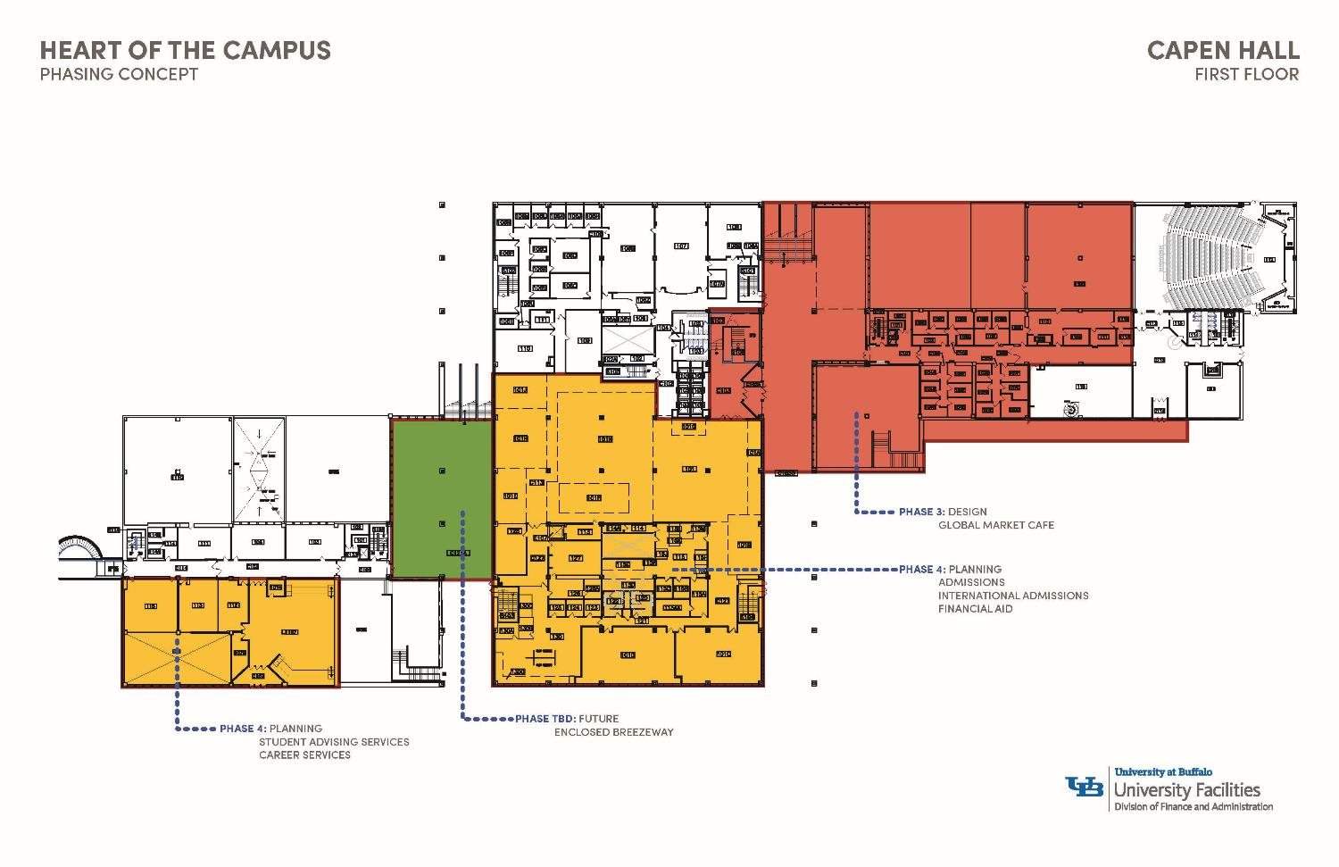

Slide 9
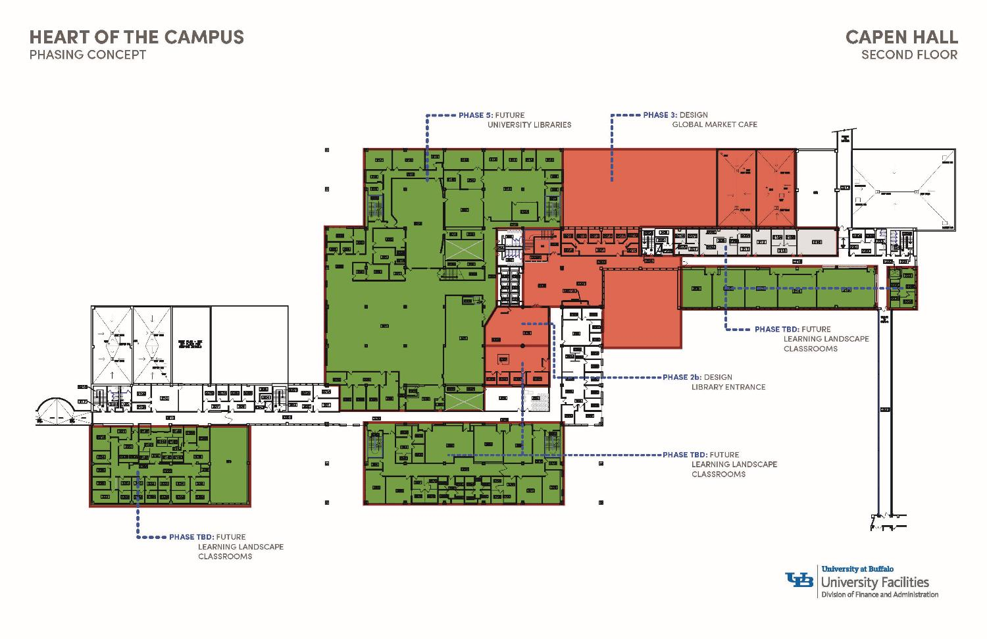

Slide 10
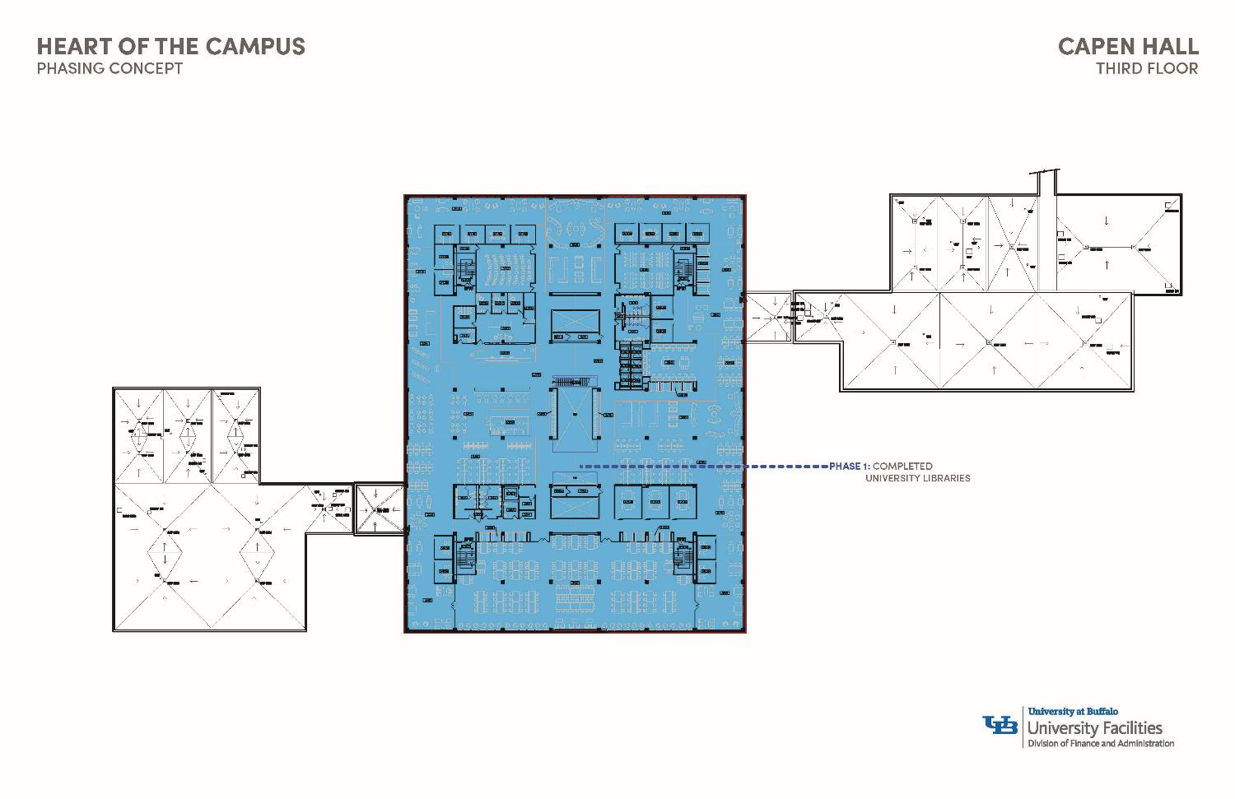

Slide 11
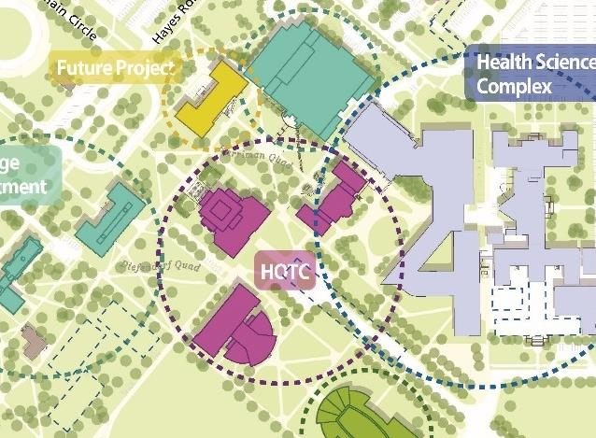

Slide 12
One world cafe
Project Details and Status

Slide 13
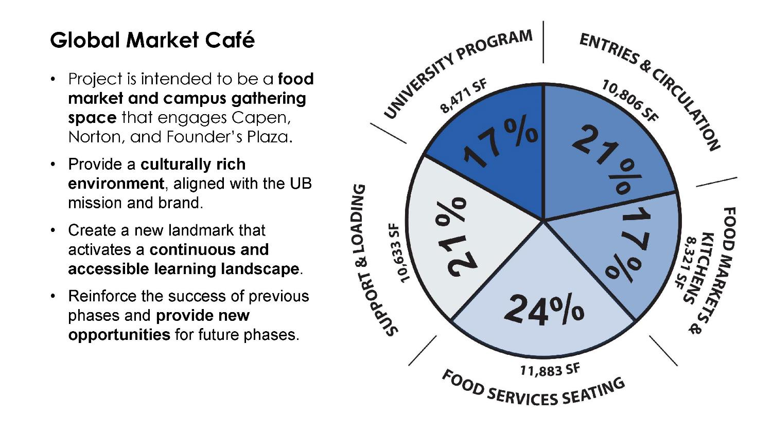

Slide 15
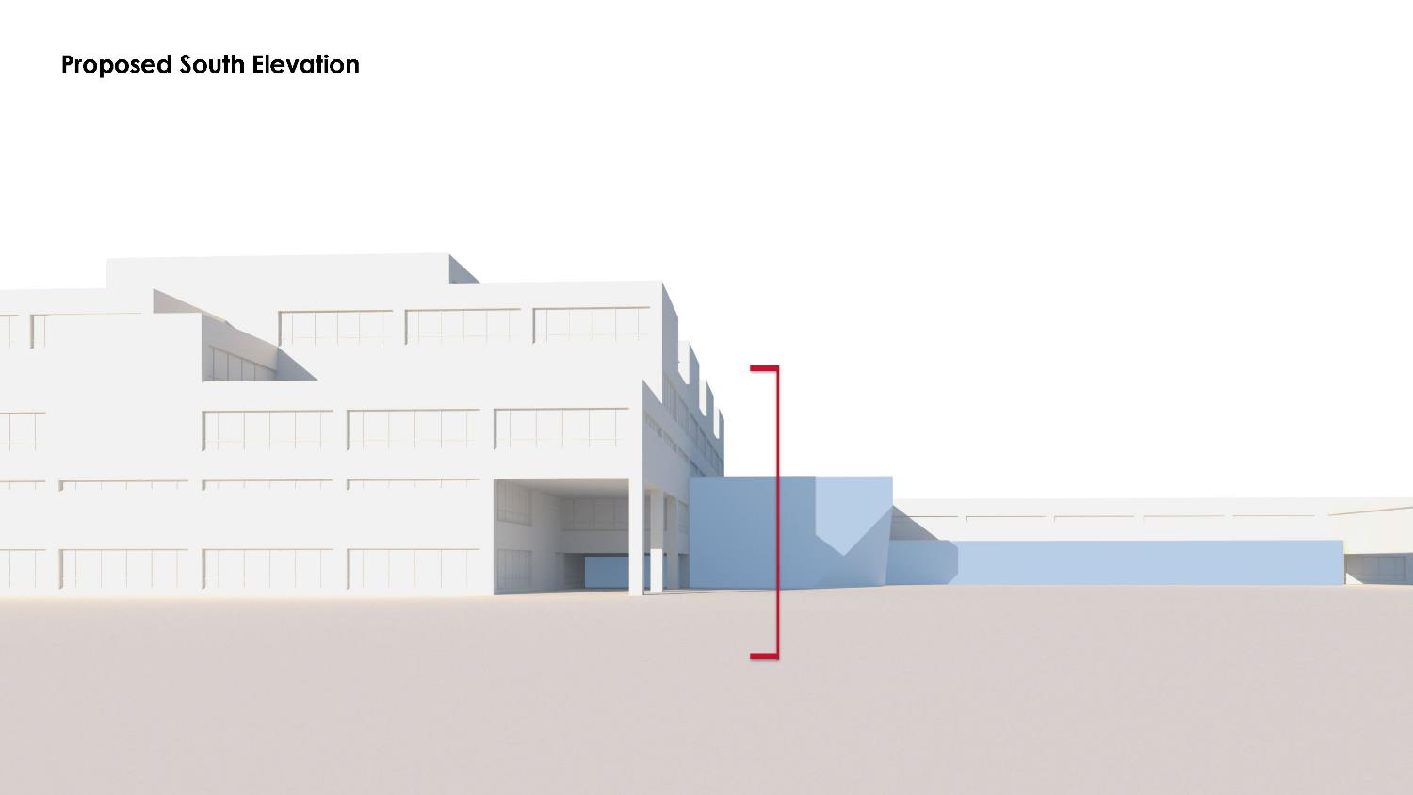

Slide 17
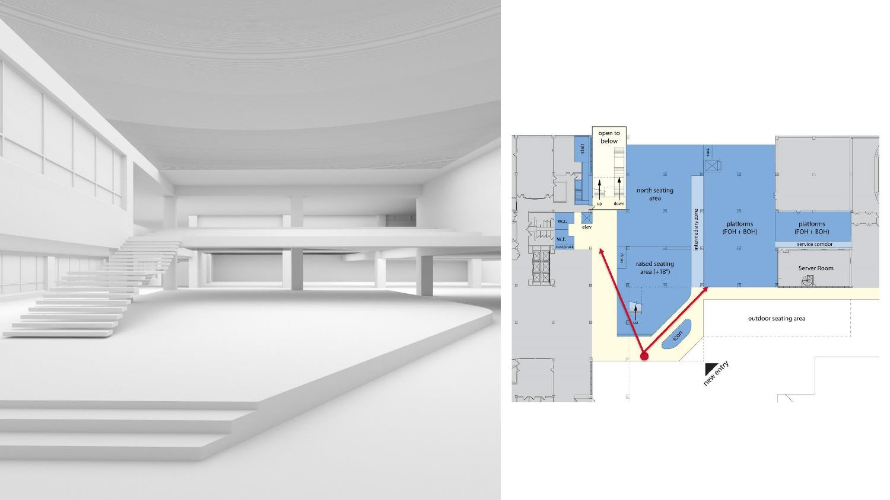

Slide 18
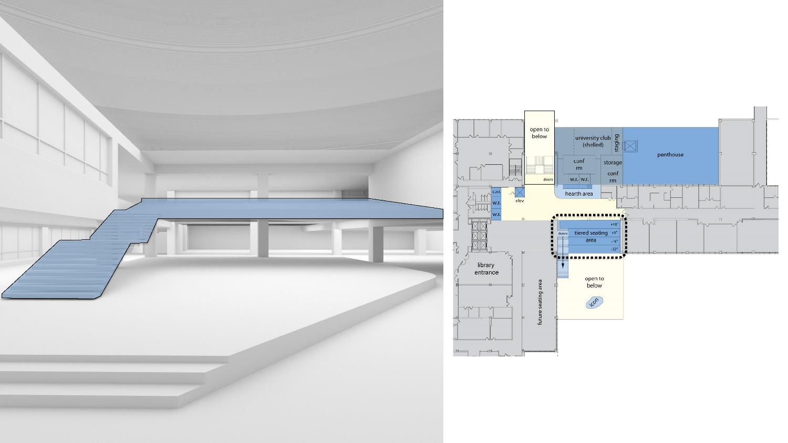
future phase

Slide 21
One World cafe
Questions

